Slide 1
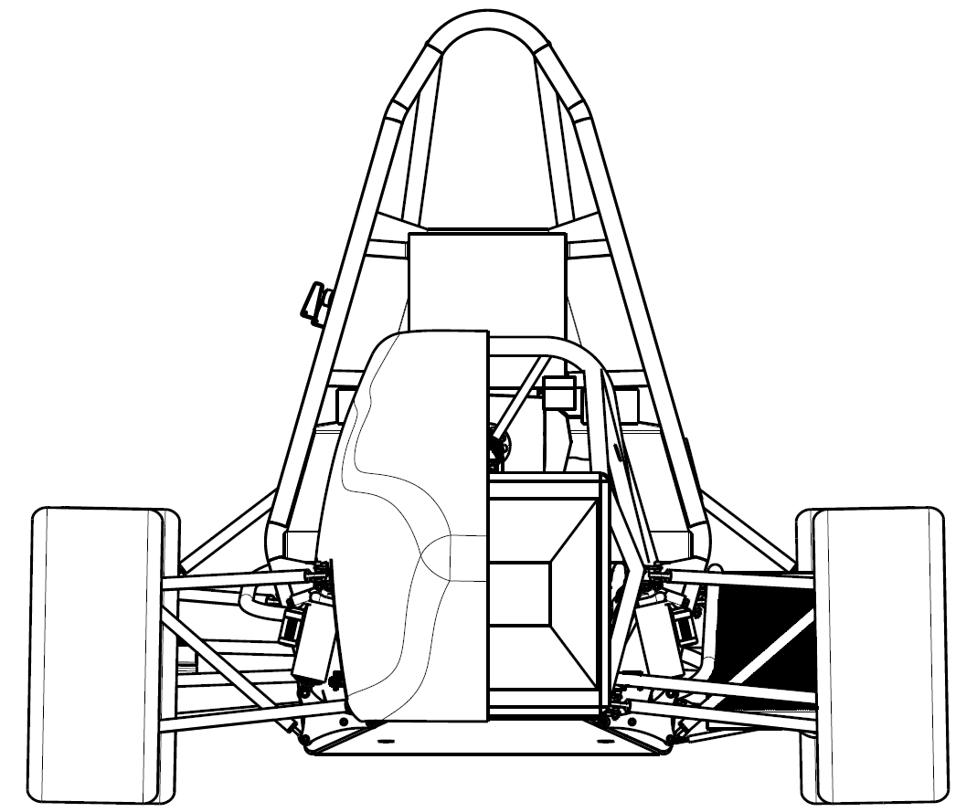

A - Overall vehicle concept
Management Document
Concept Class FSUK 23/07/2021

Slide 2
Objectives
1st electric vehicle: Pass the Scrutineering + Finish endurance
Focus on reliability
Event | Objective | Max pts
Cost Event | 75 | /100
Business Event | 60 | /75
Design Event | 80 | /150
Skid Pad | 30 | /75
Acceleration | 30 | /100
Autocross | 40 | /125
Endurance | 125 | /275
Efficiency | 10 | /100
Total | 450 | /1000
Event | Objective
SkidPad | 5,3 sec
Acceleration | 4,4 sec
Endurance | Finish

Slide 3
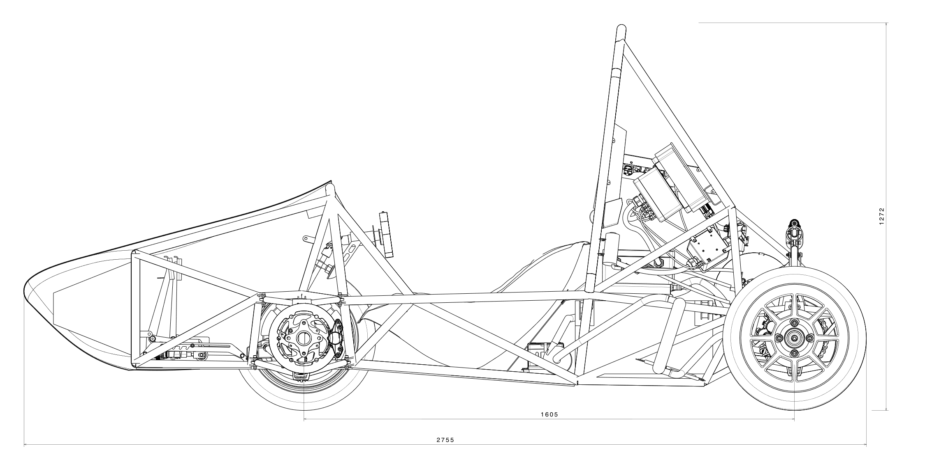
The vehicle: Valkyriz
Electric powered
Mass: 230 kg
2 Driven Wheels, 80 kW
13 ’’ Continental C19
No aerodynamic devices

Slide 4
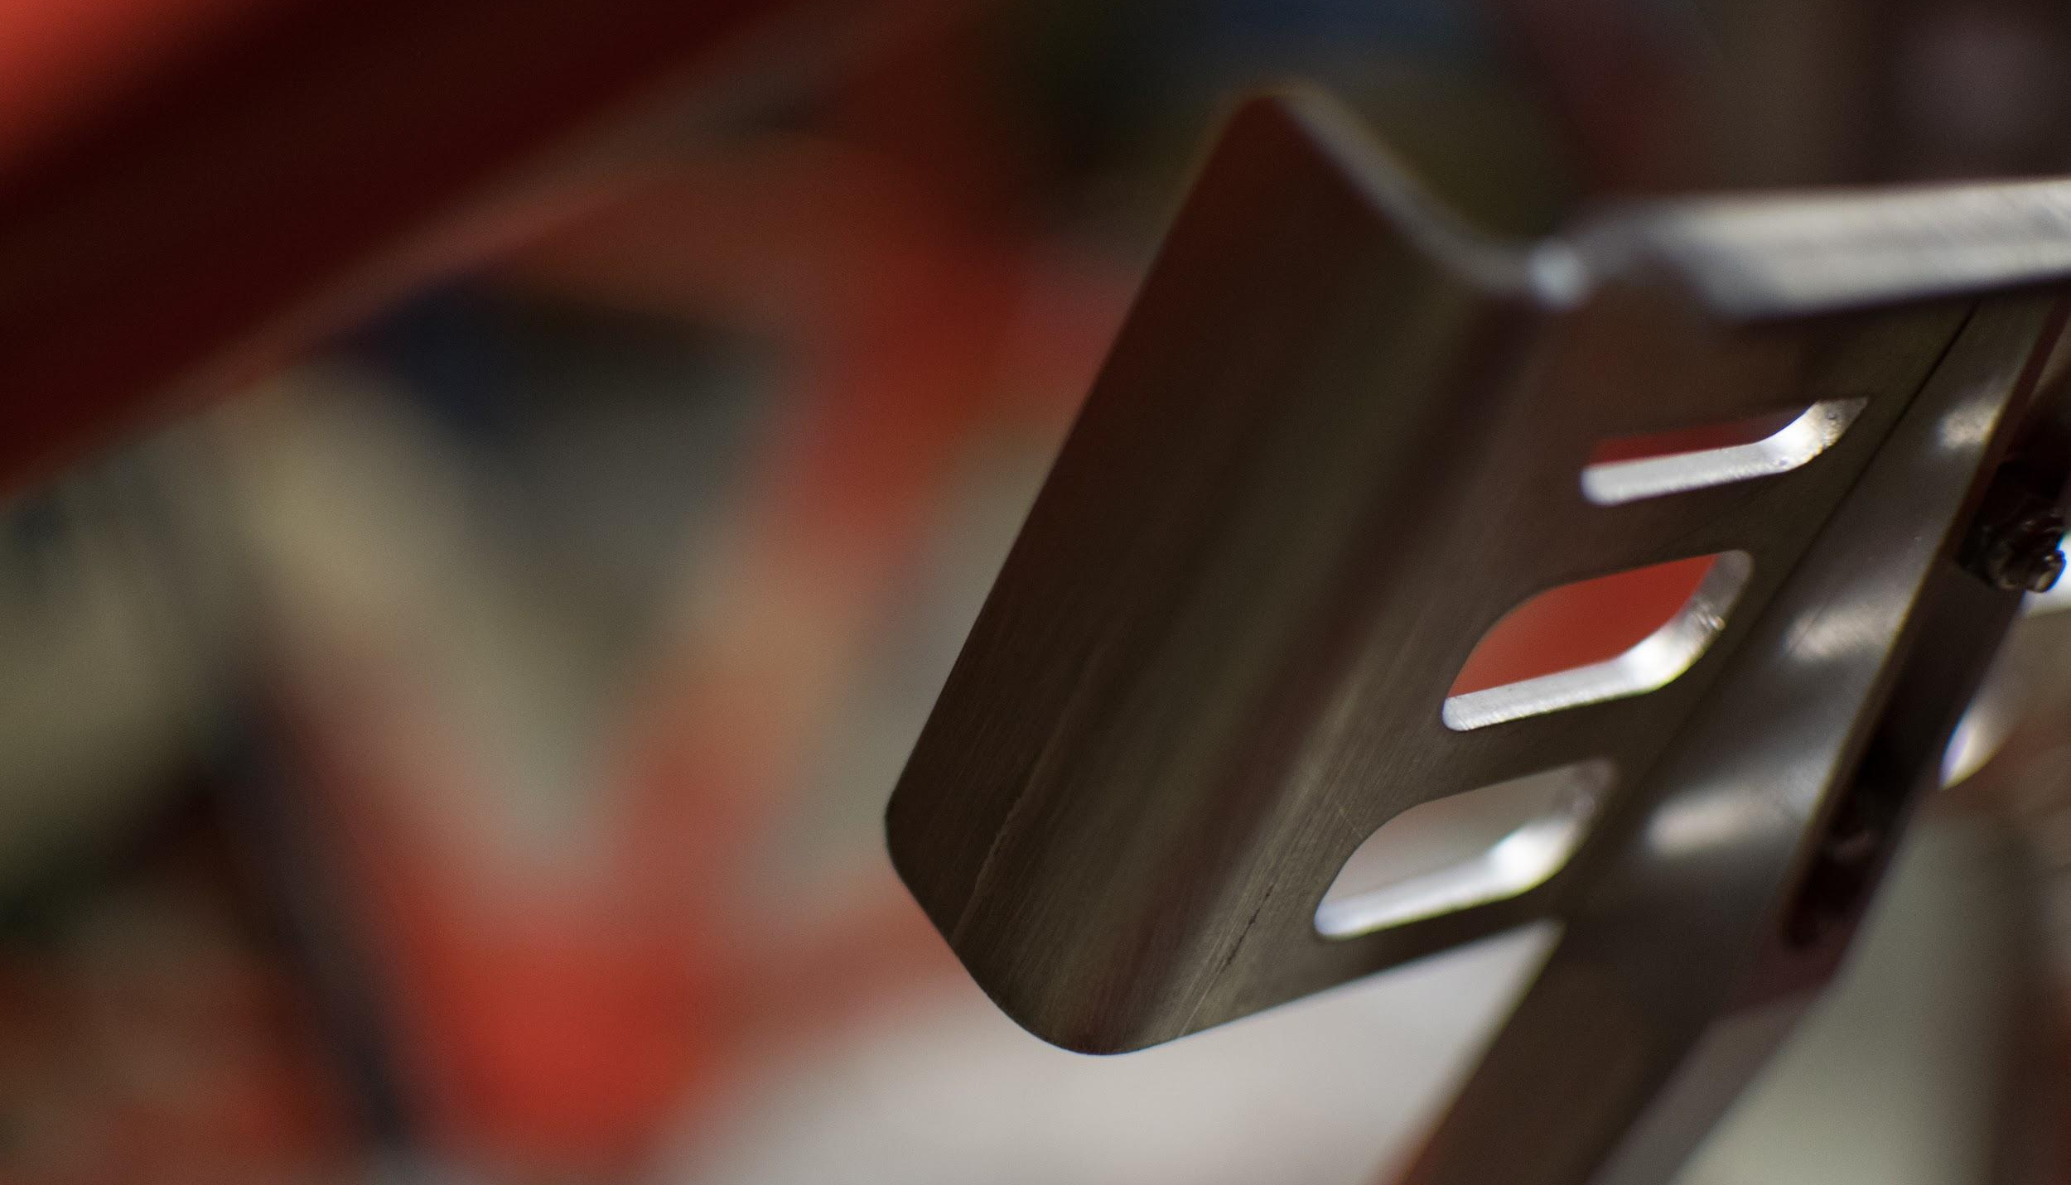
Frame & Body

Slide 5
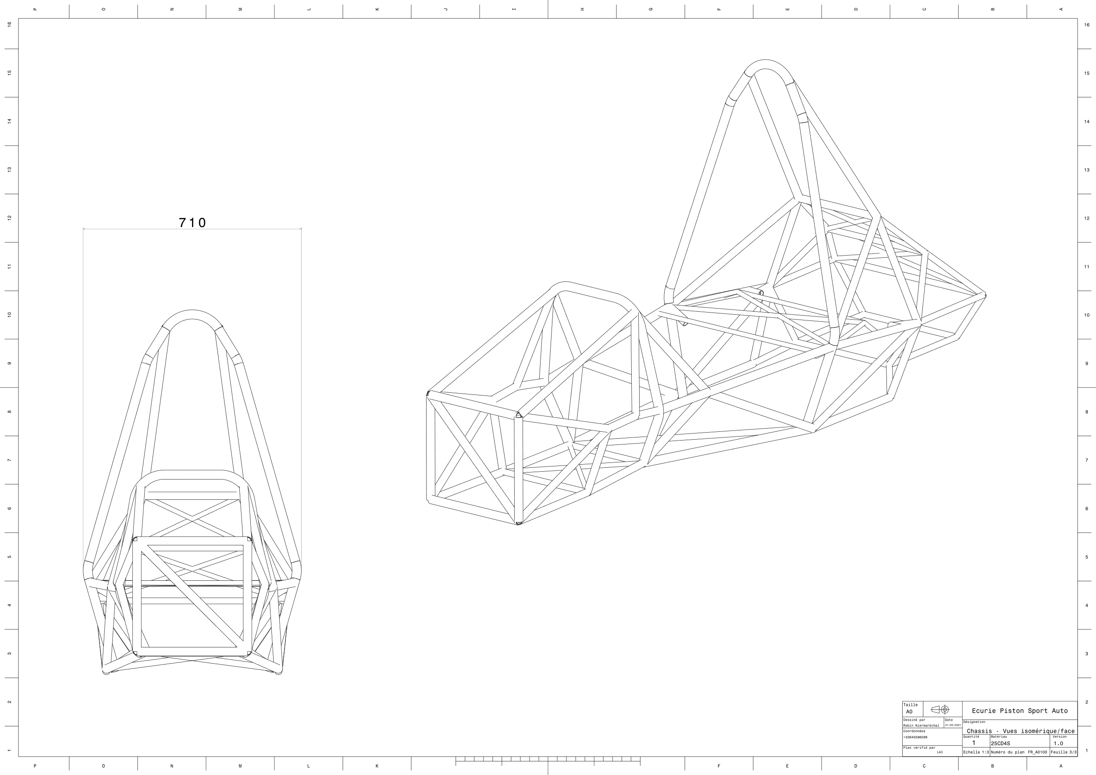
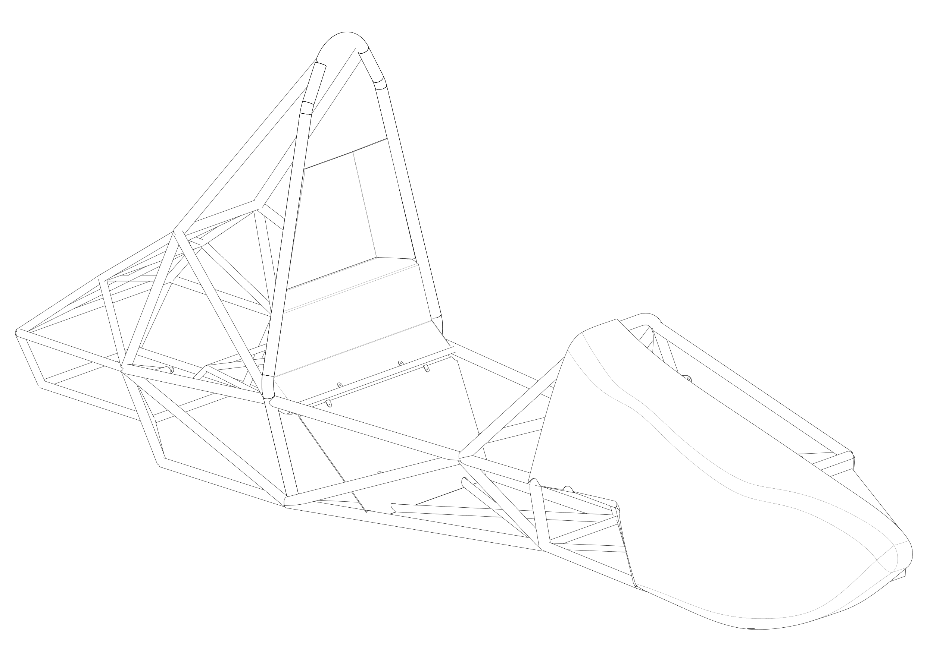
Frame & Body
Steel space frame: 34,6 kg
Glass fibre body

Slide 6
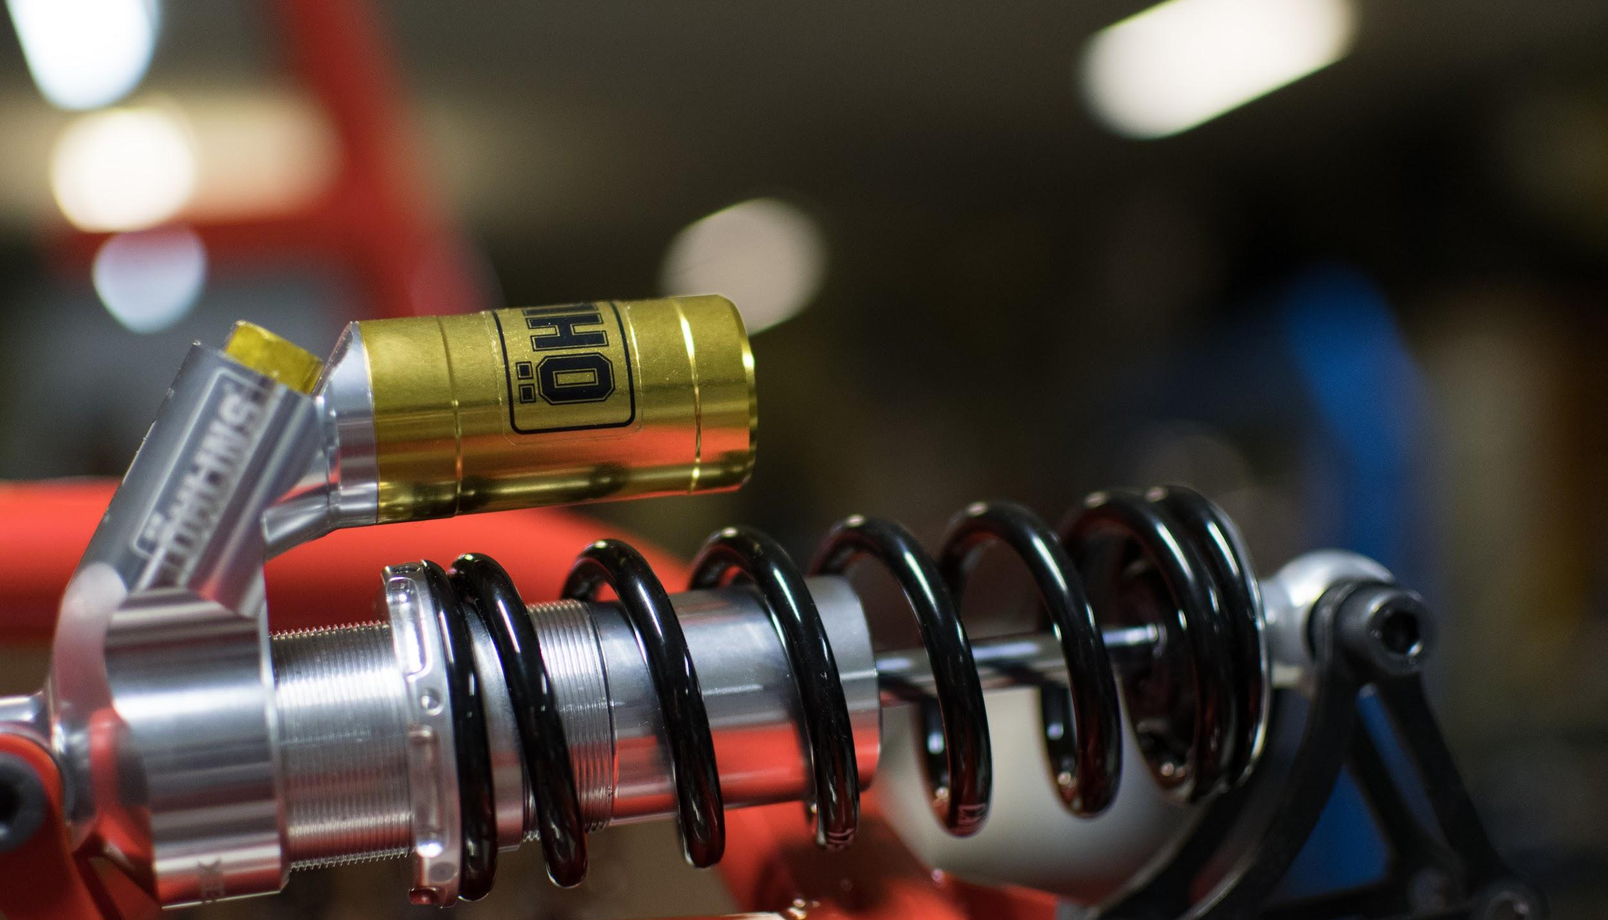
Suspension system

Slide 7
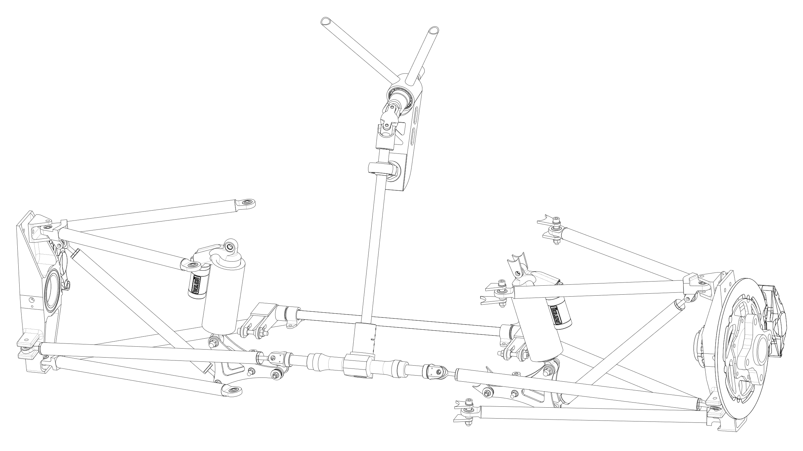
Front Suspension System
Anti roll bar
Double wishbone
Pull rod
Parallel steering system

Slide 8
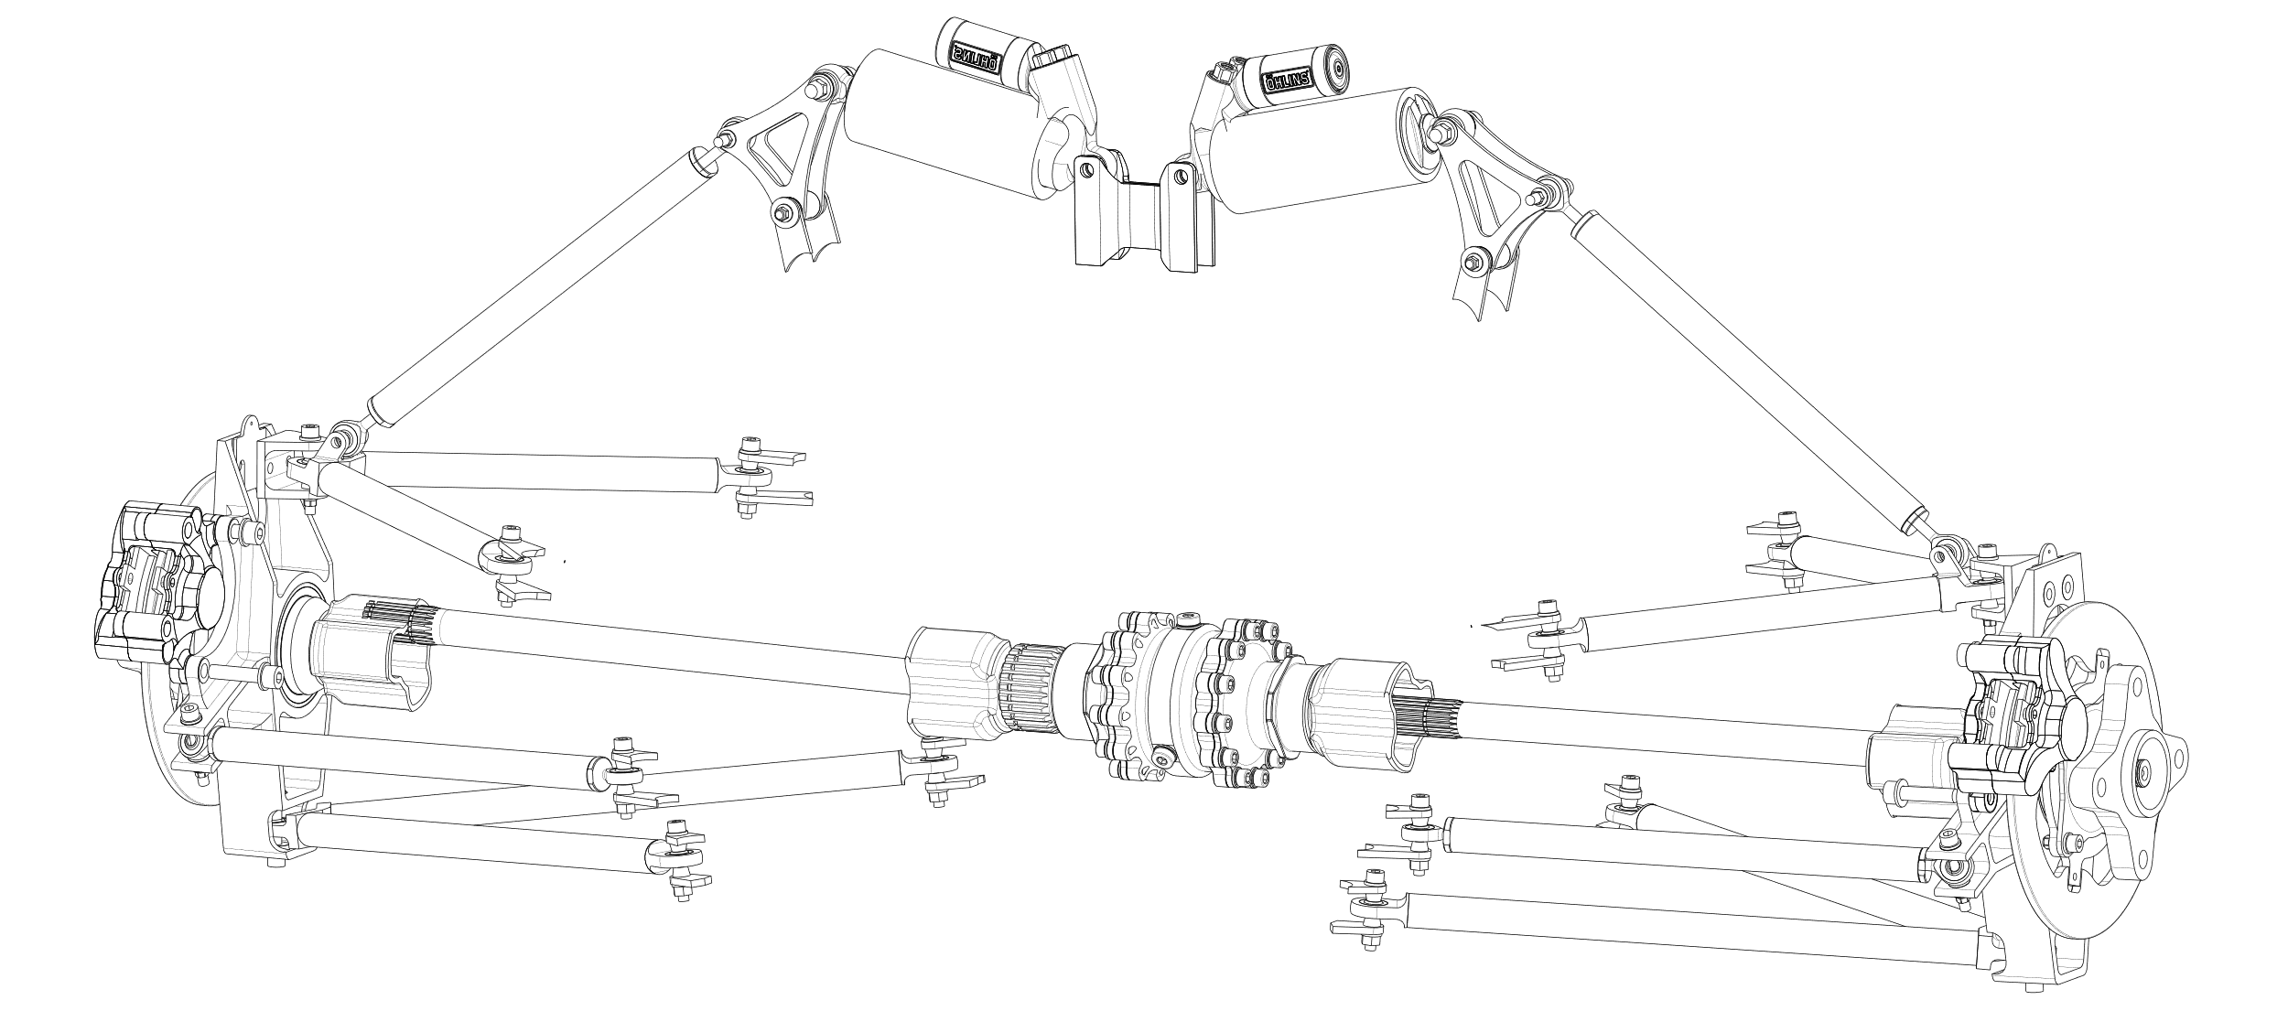
Rear Suspension System
Double wishbone
Push Rod
Drexler limited slip differential

Slide 9
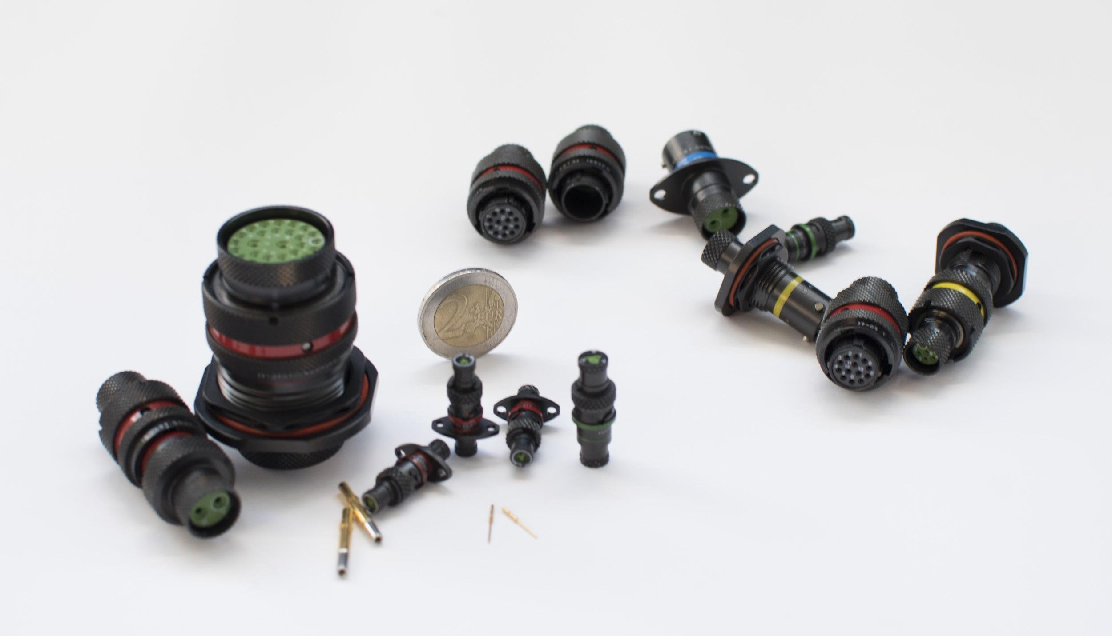
Powertrain

Slide 10
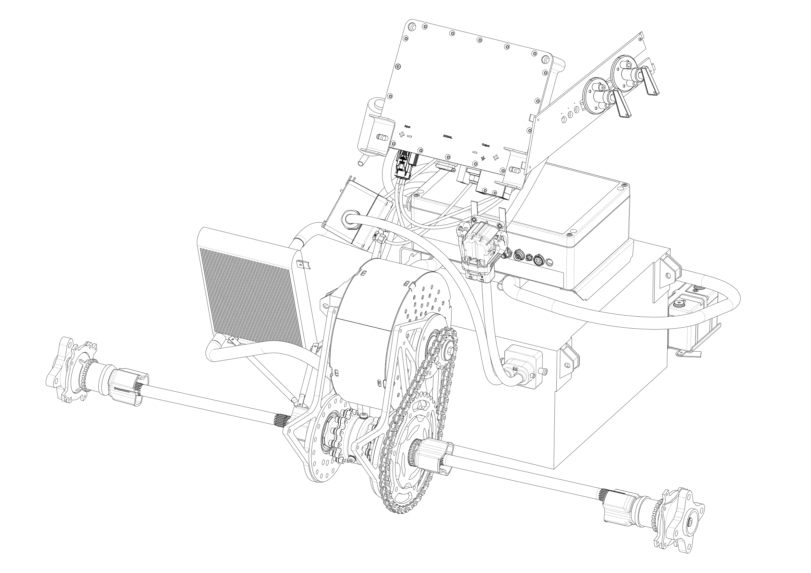
Powertrain
One Motor EMRAX 228: 80 kW
Inverter BAMOCAR D3
Liquid Cooling system
Accumulator: 7.3 kWh
2 driven wheels

Slide 11
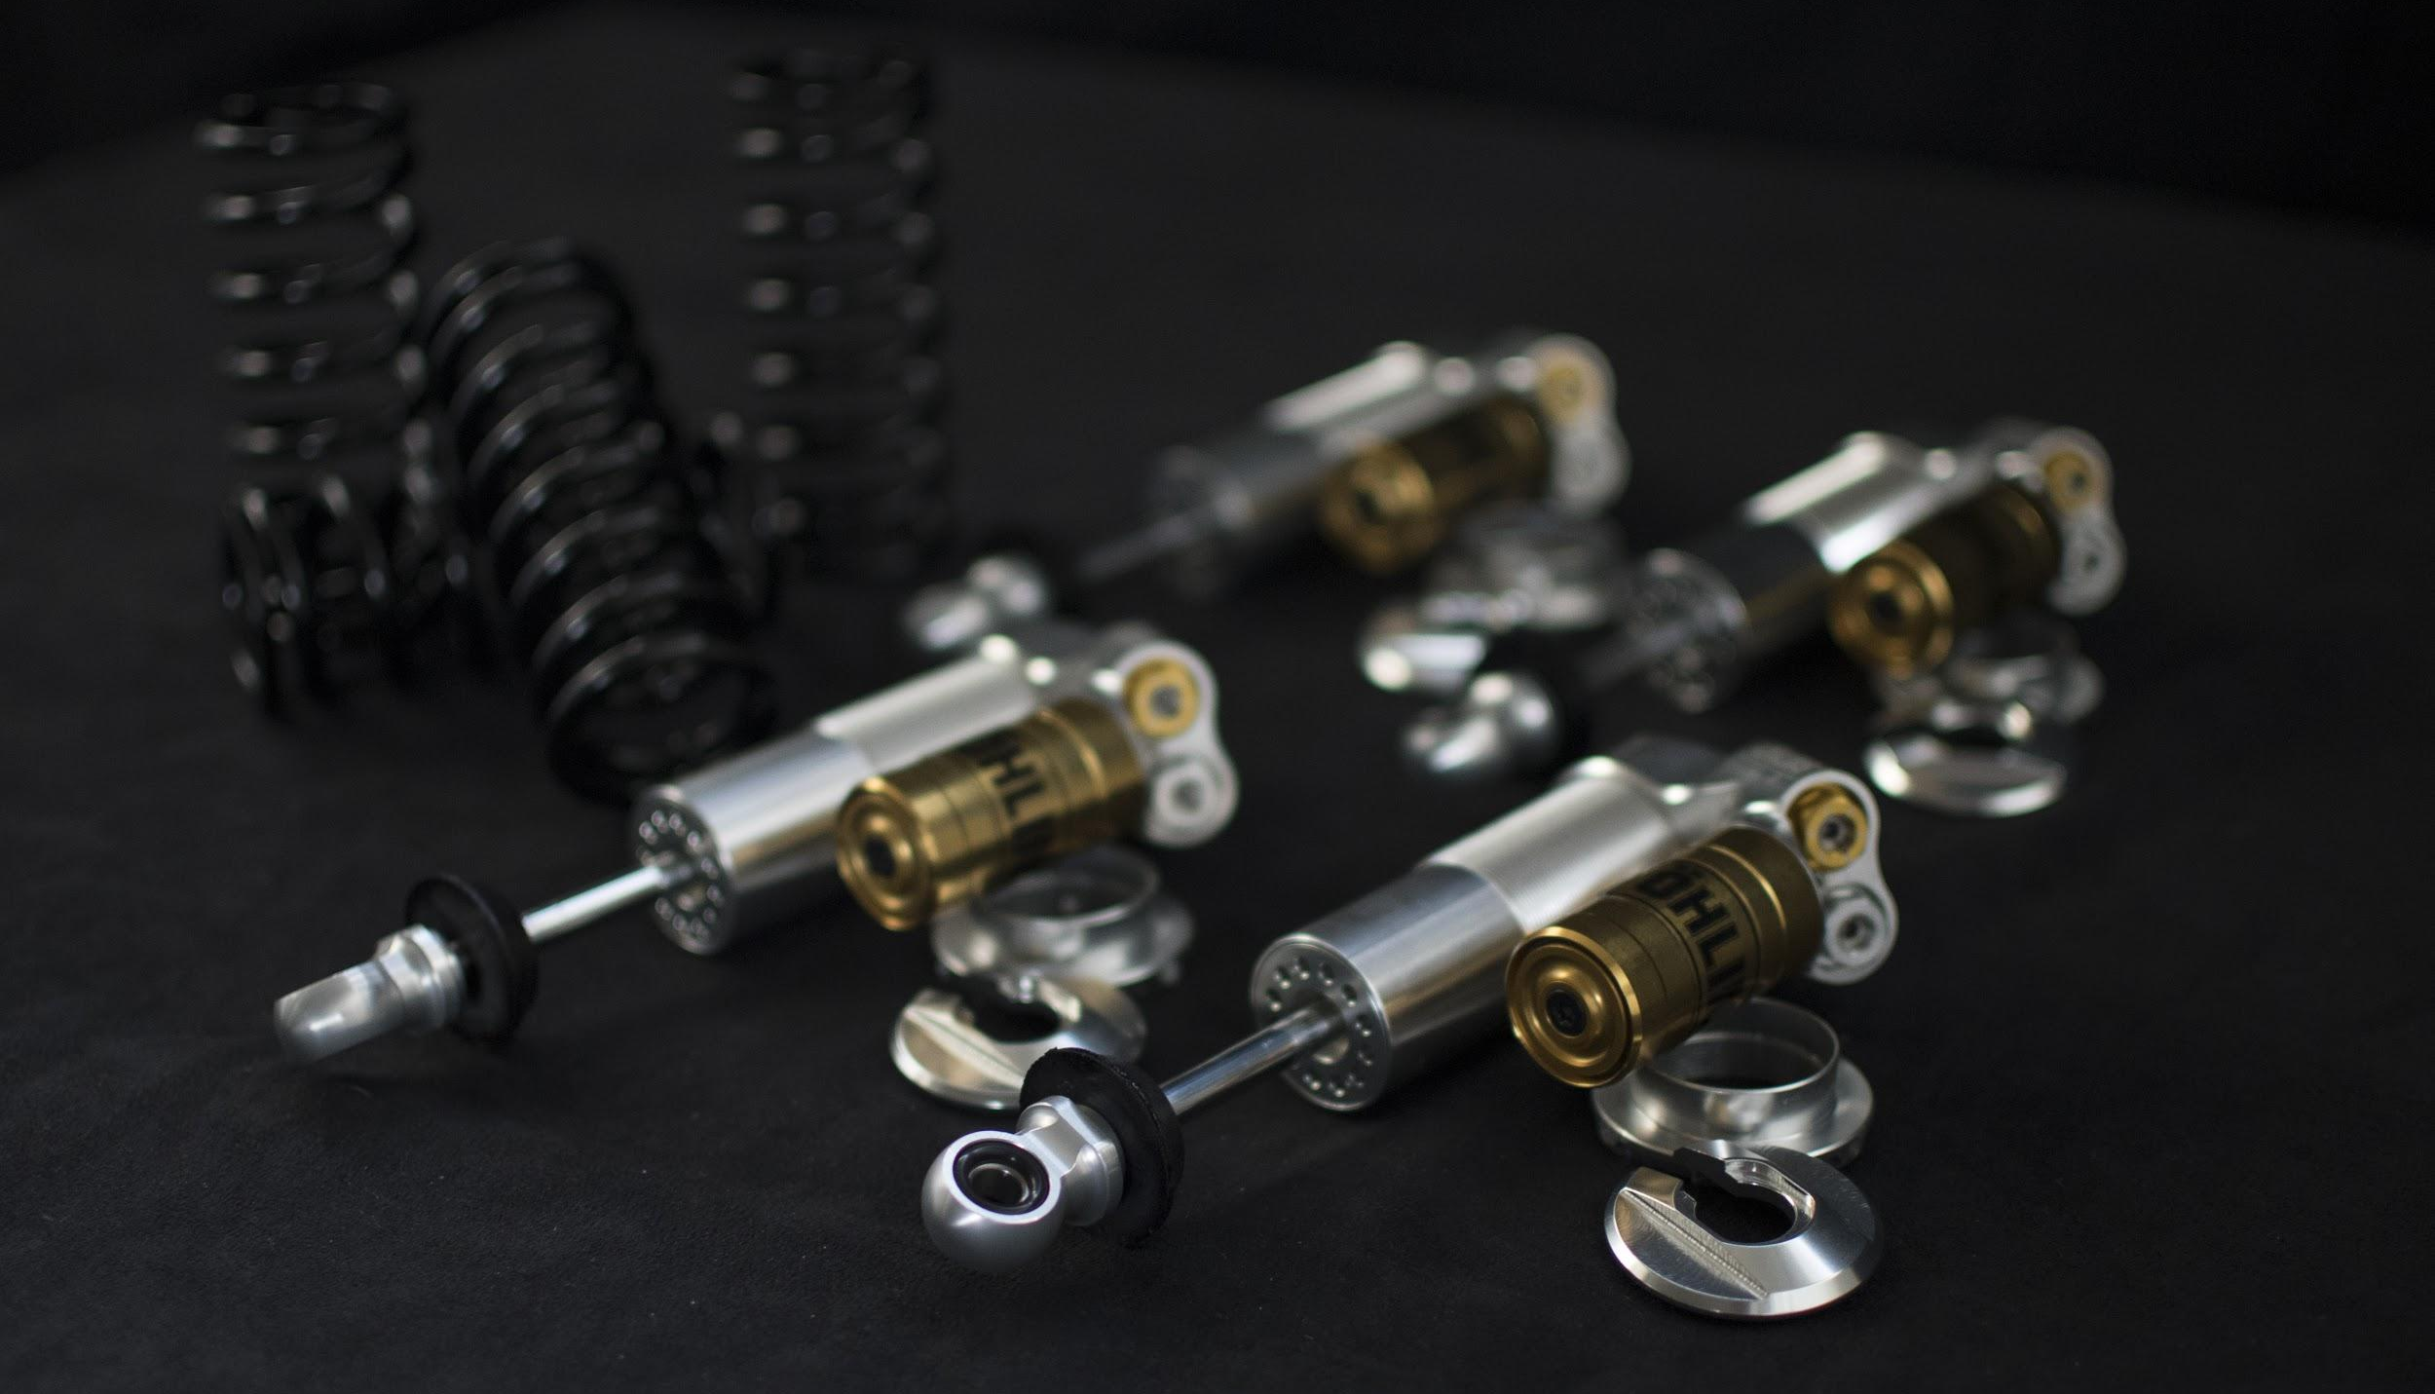
Overview

Slide 12
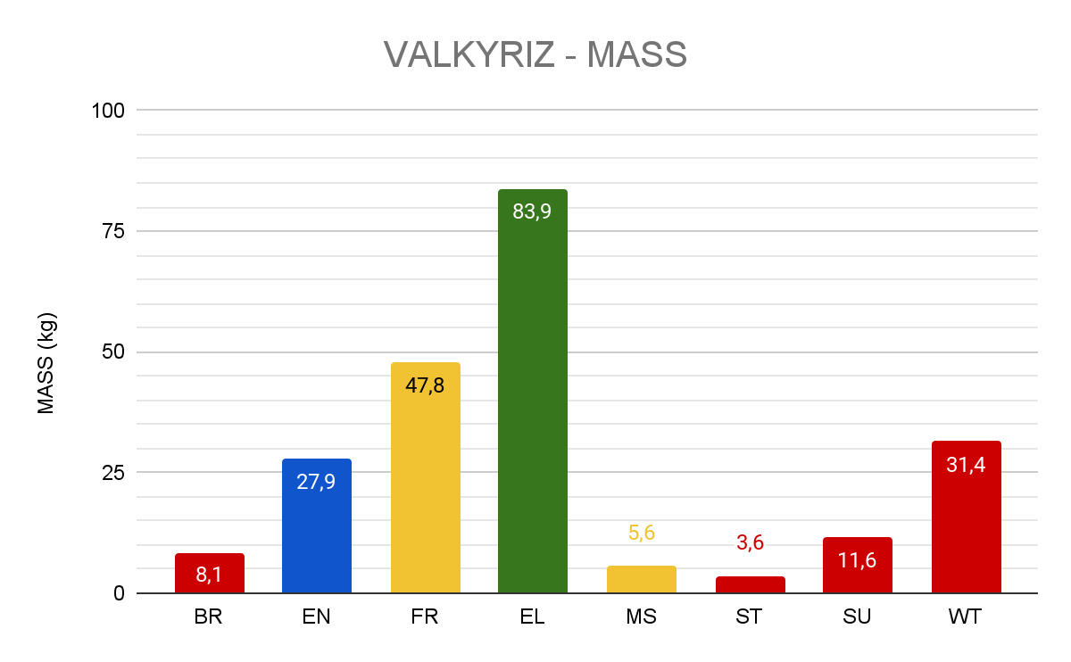
Mass schedule
Total mass: 218 kg

Slide 13
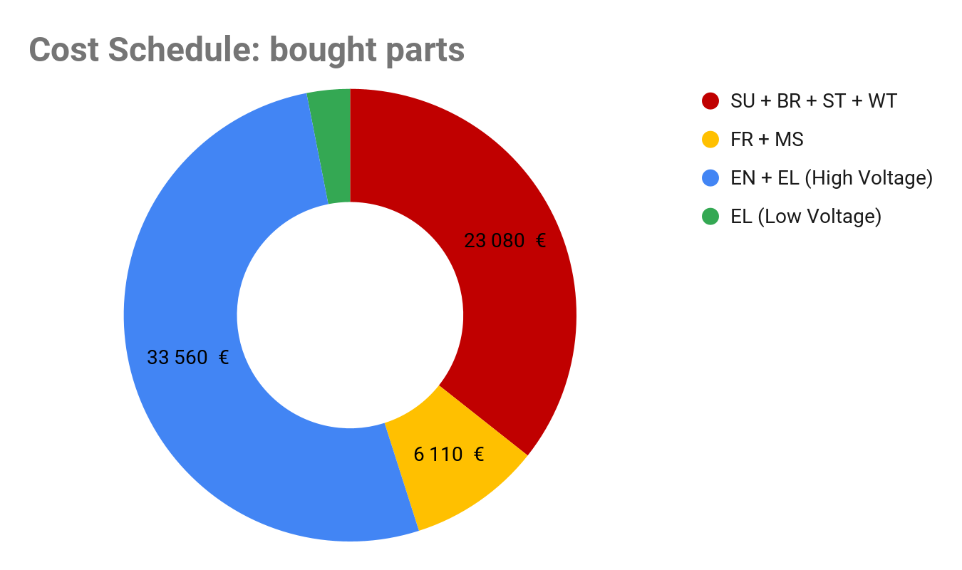
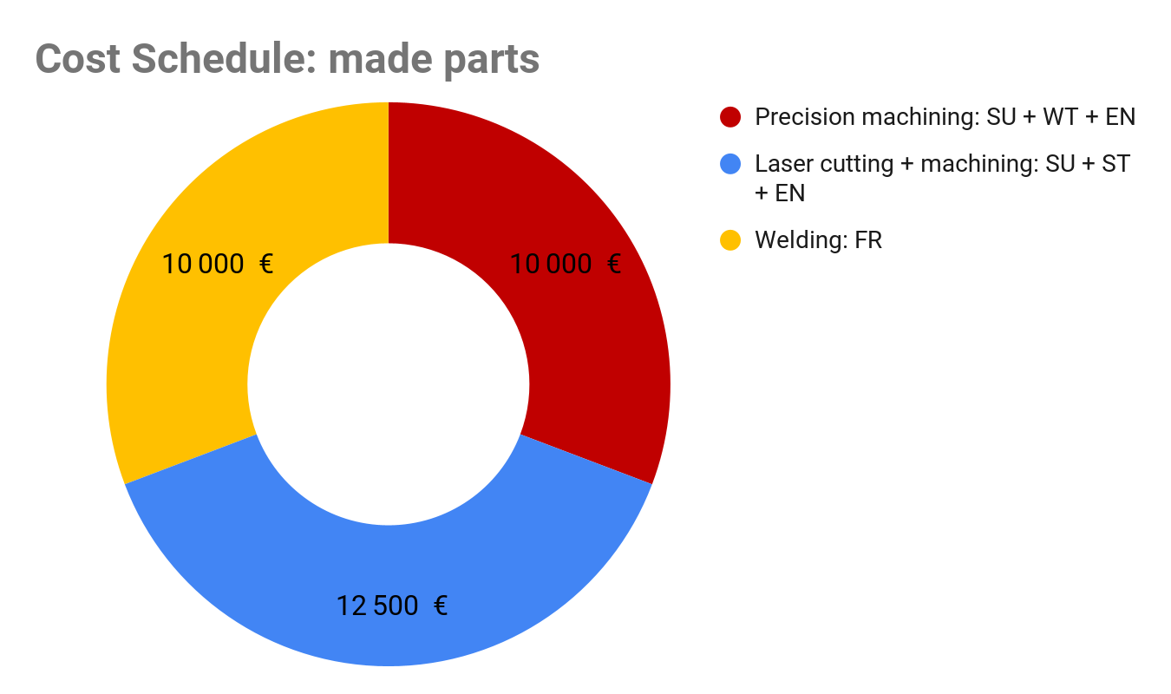
Cost schedule
Total cost: 97250 € all taxes incl.

Slide 14
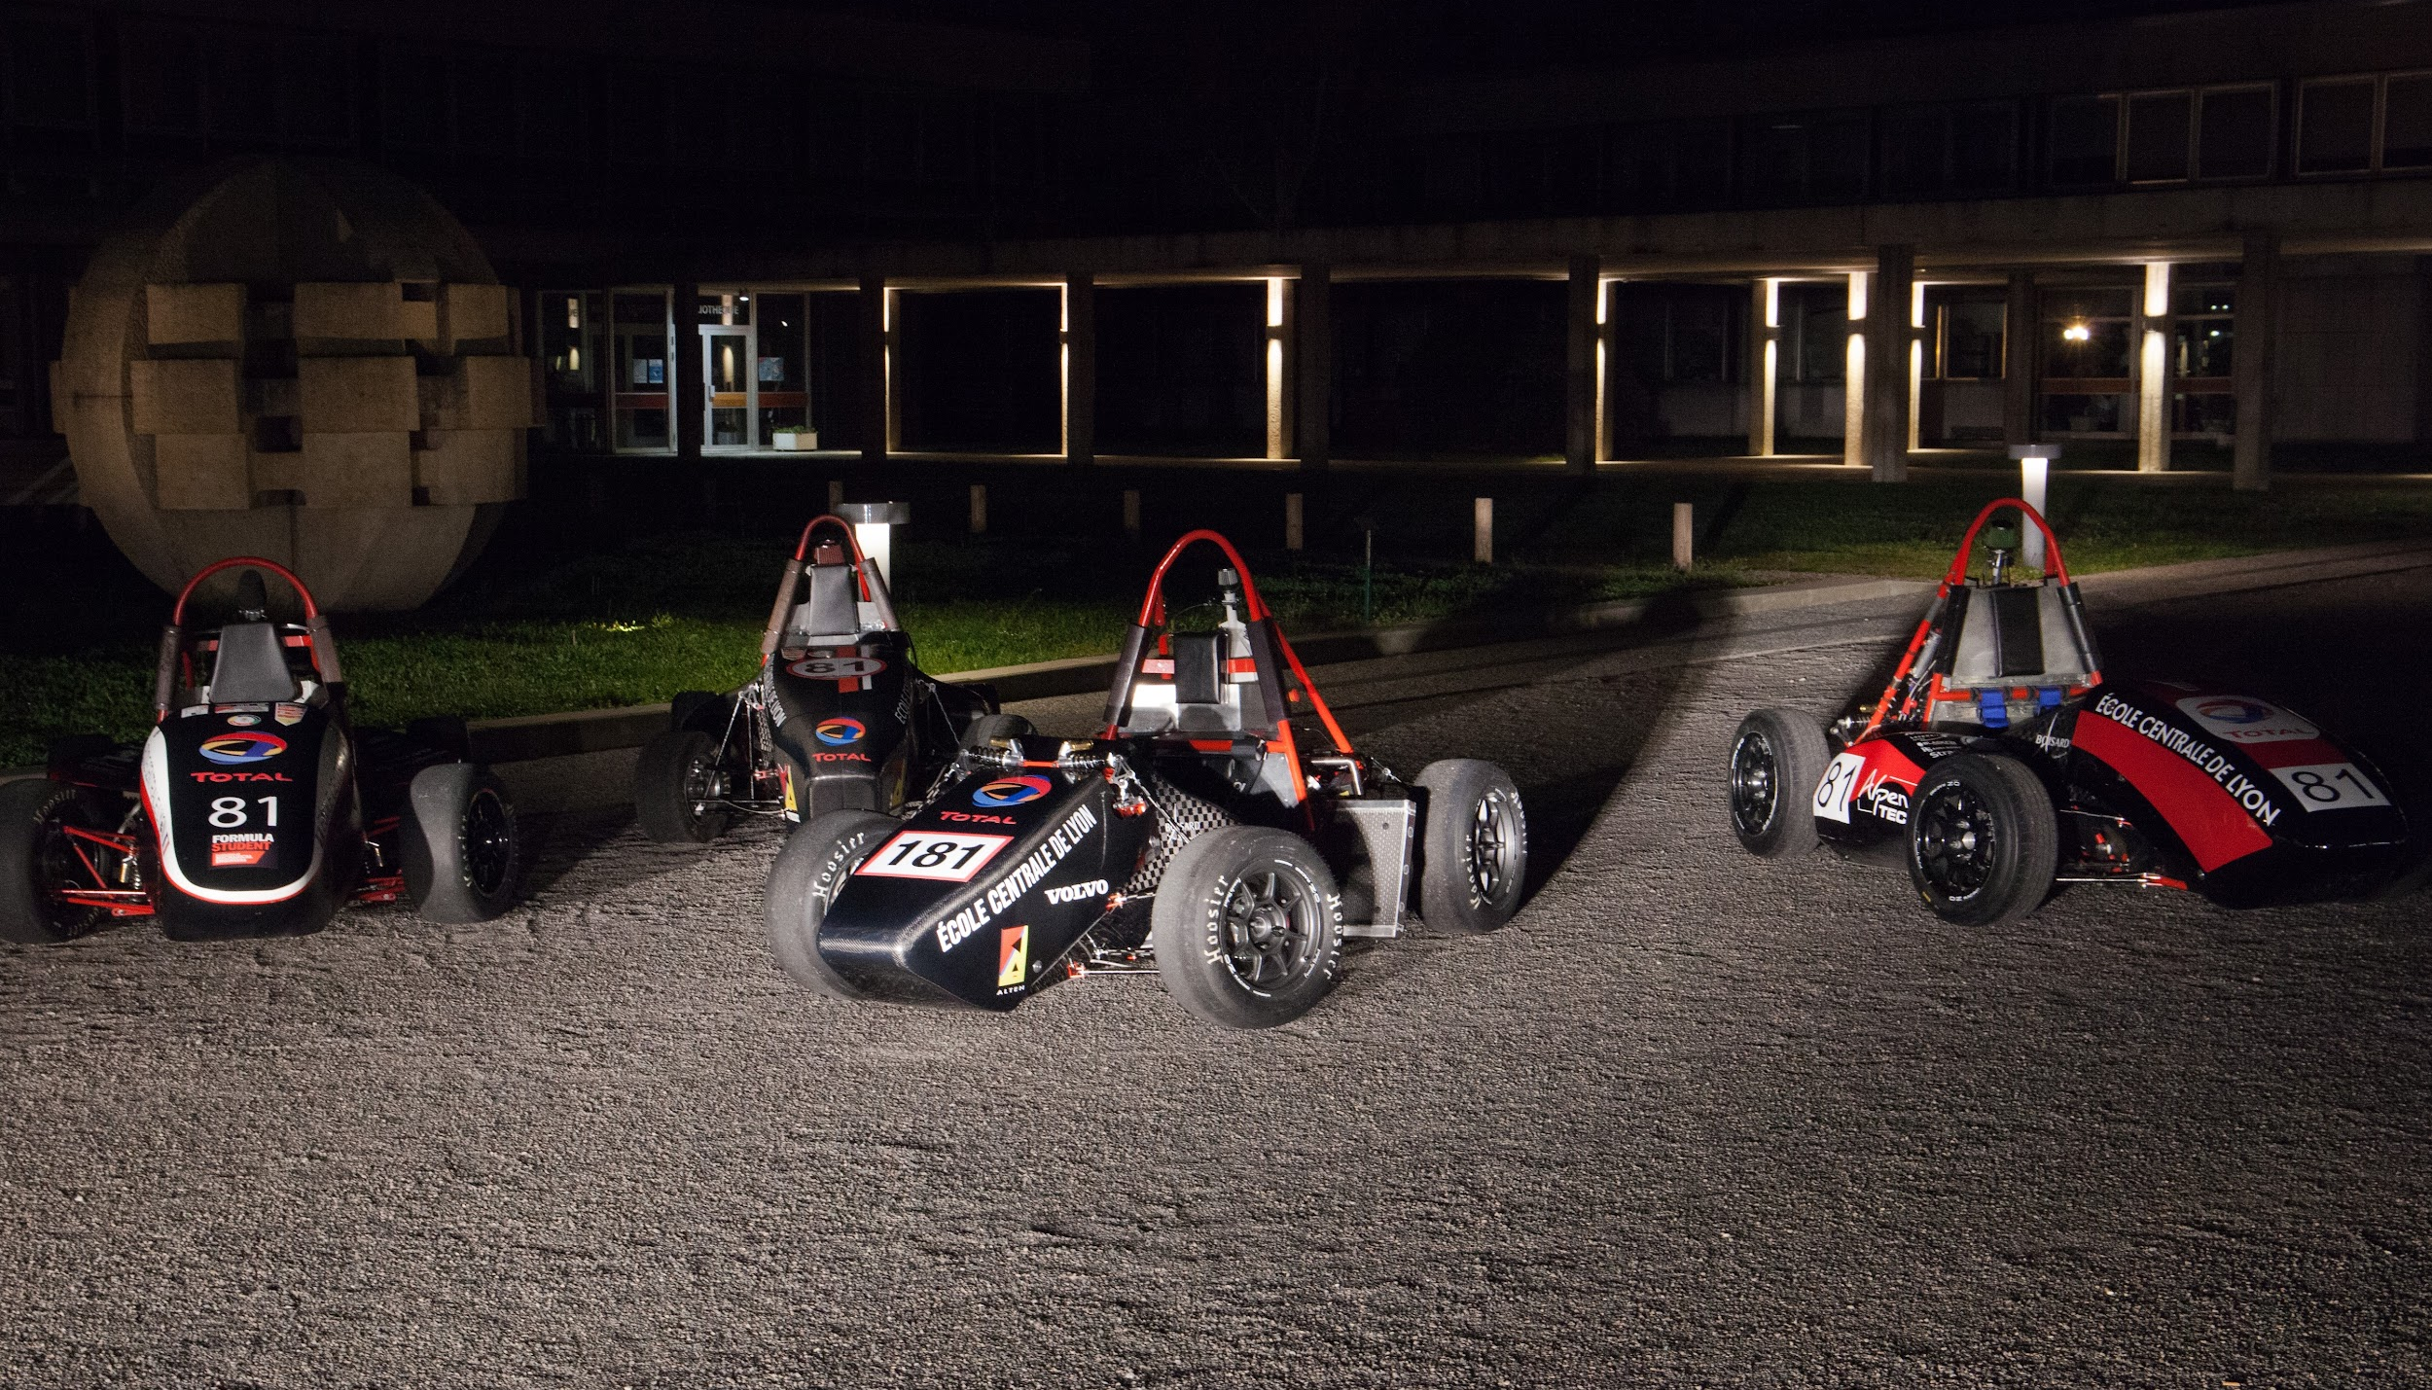
XXh - XXh
Appendices

Slide 15
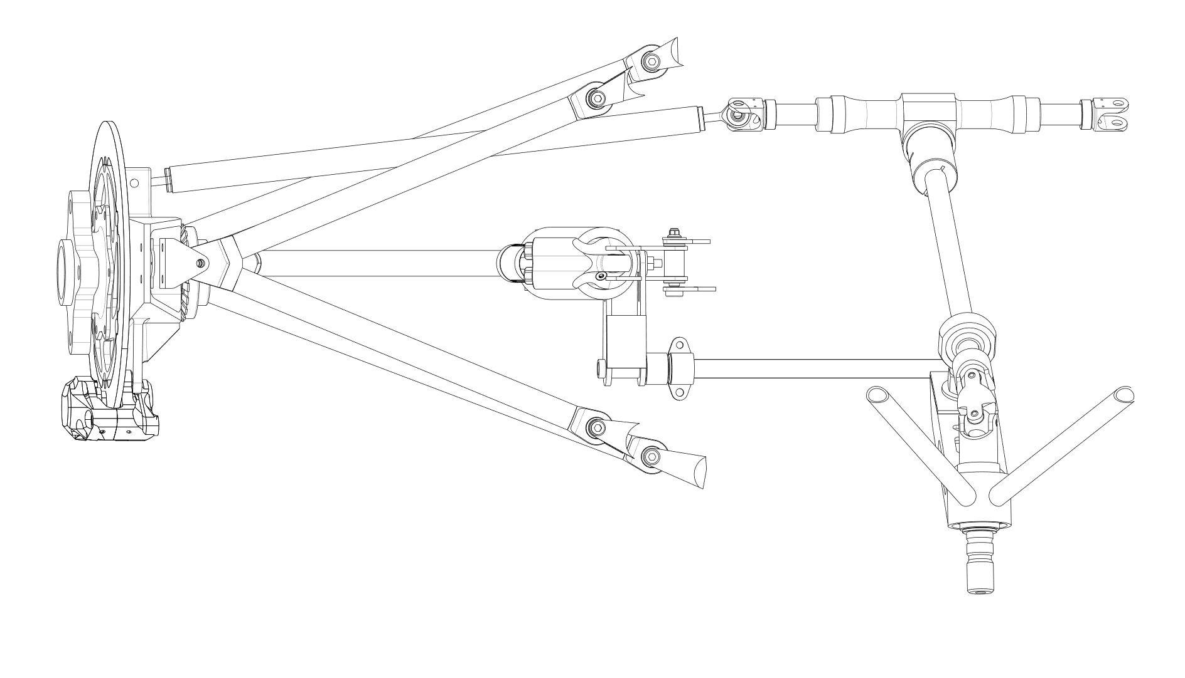
Front suspension: Top View

Slide 16
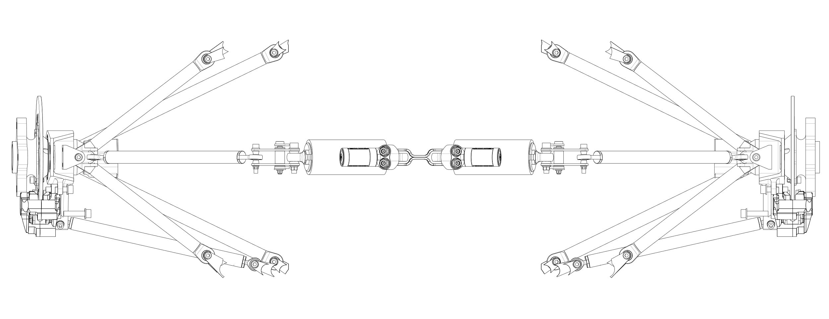
Rear suspension: Top View

Slide 17
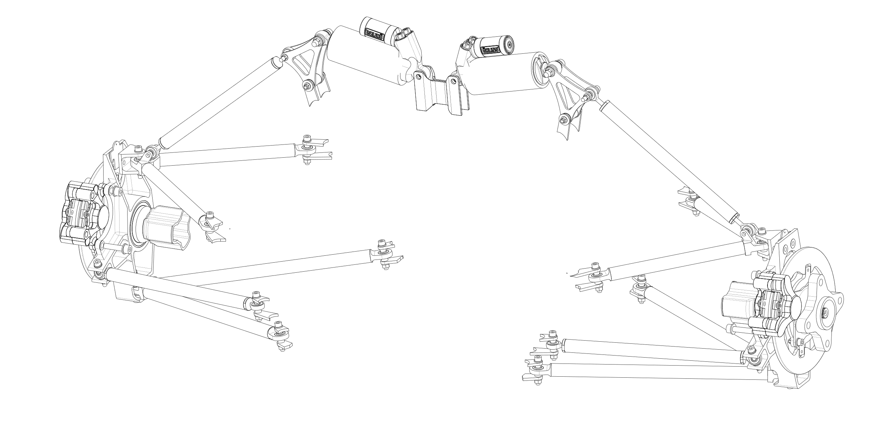
Rear suspension system

Slide 18
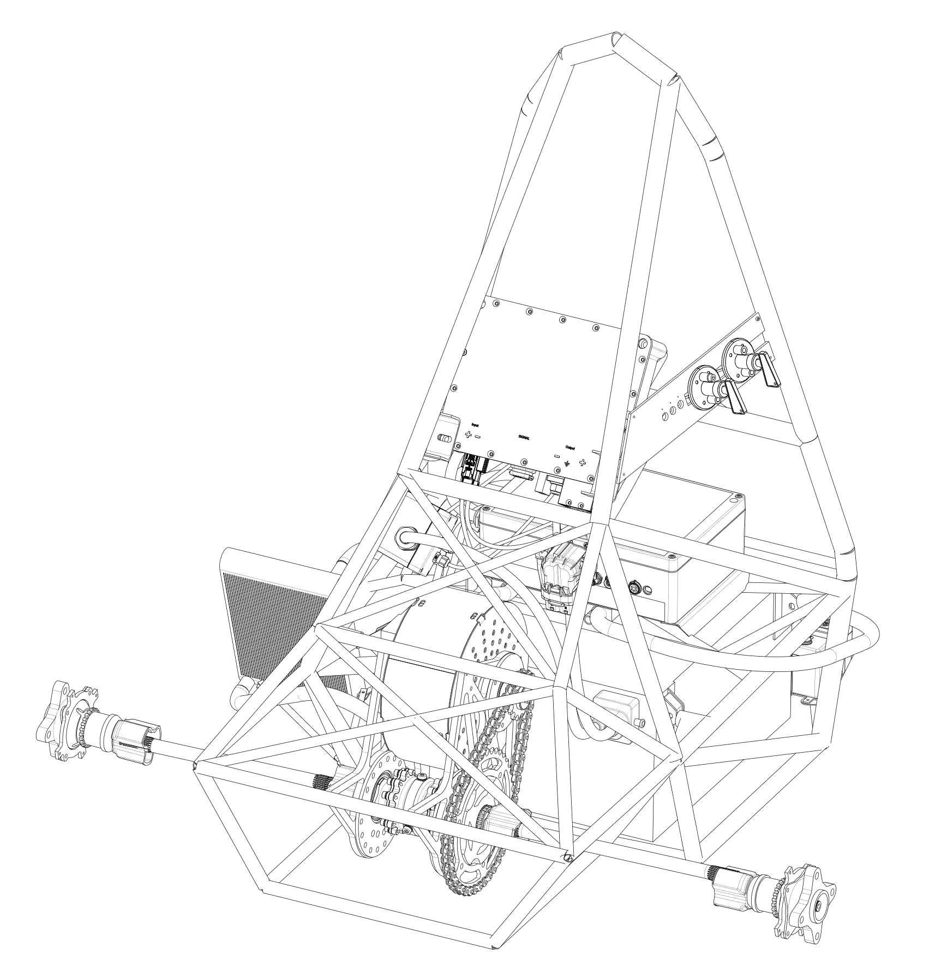
Powertrain integrated into the Frame

Slide 19
Frame

Slide 20
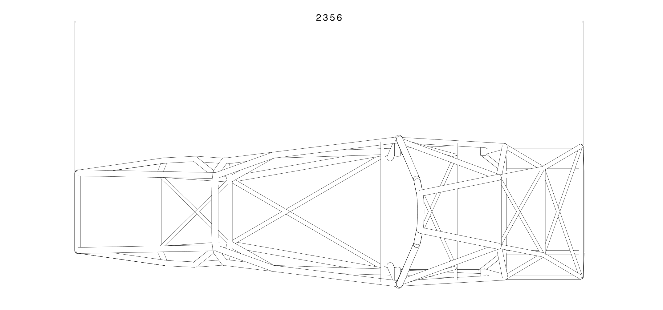
Frame: Top View

Slide 21
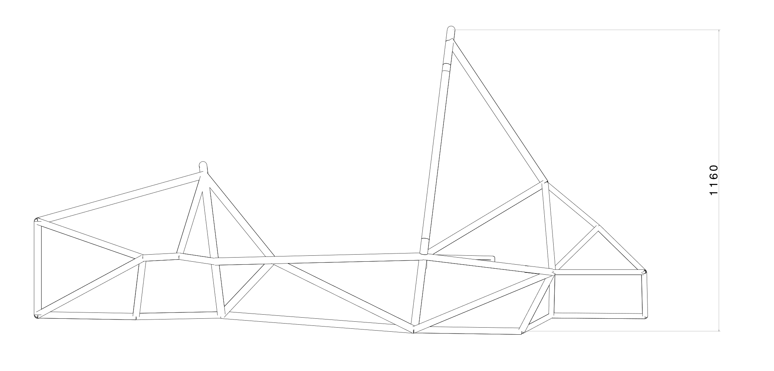
Frame: Side View

Slide 22
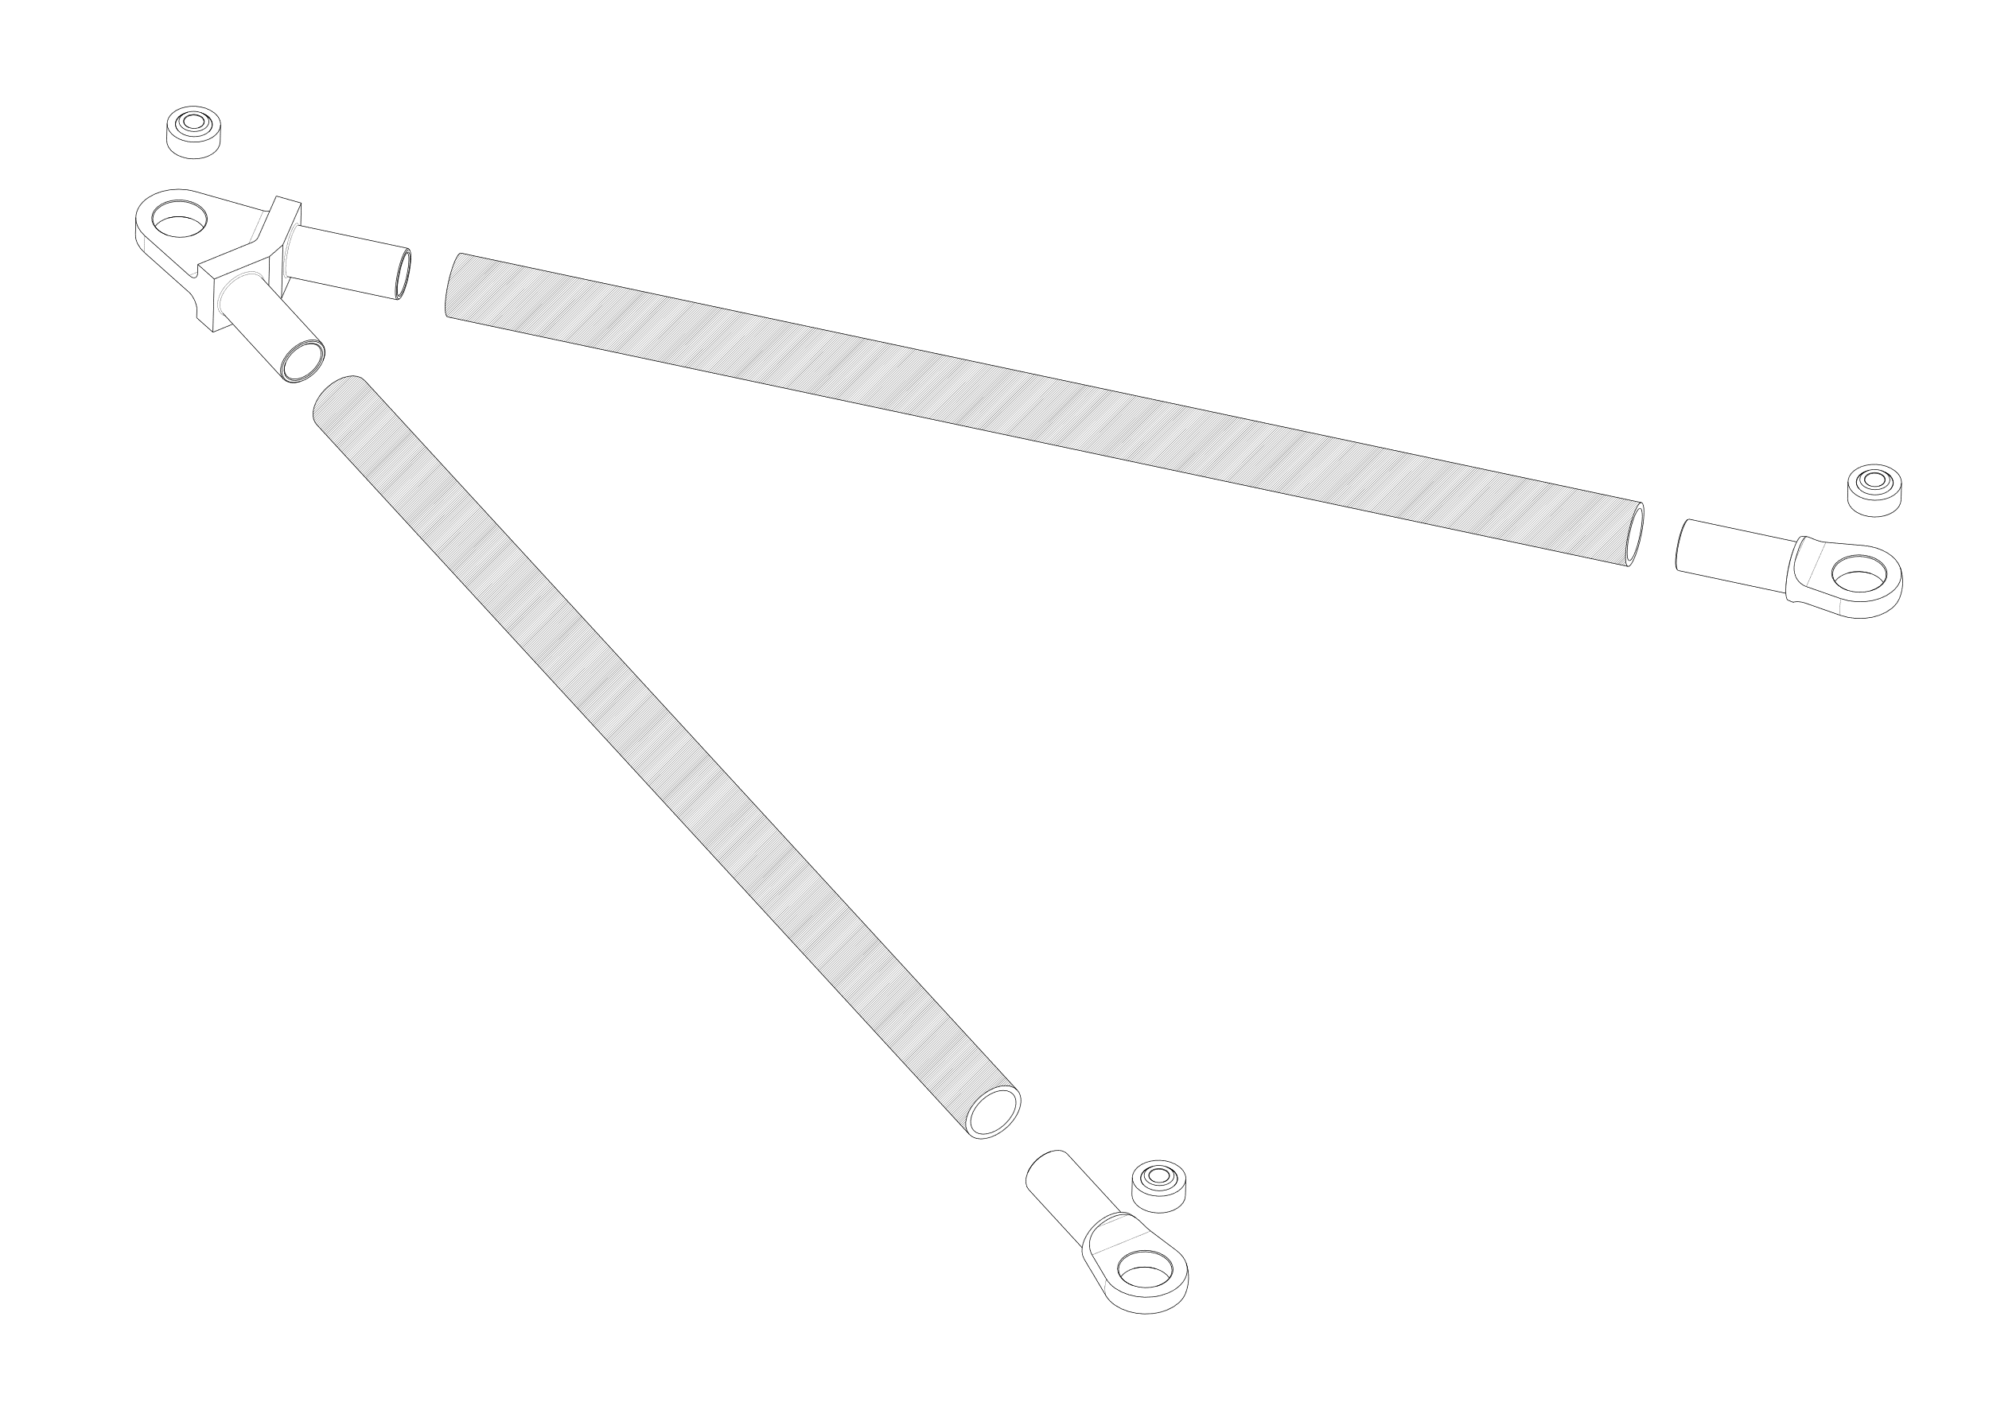
A-Arms

Slide 23
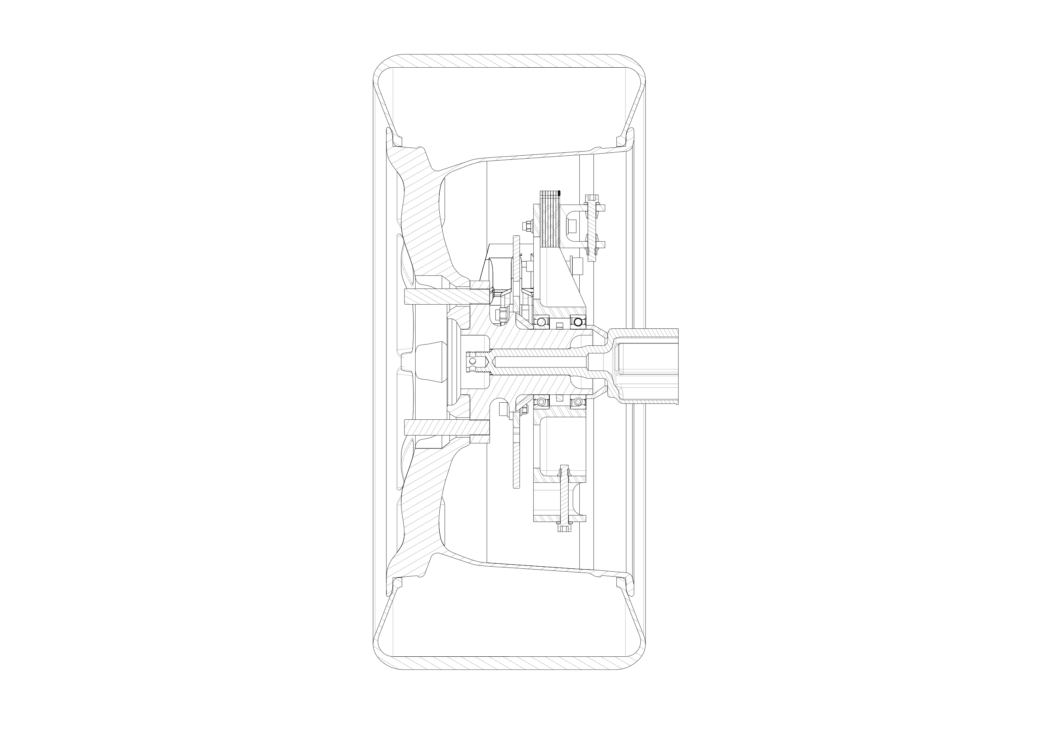
Wheel Assembly

